Slide 1
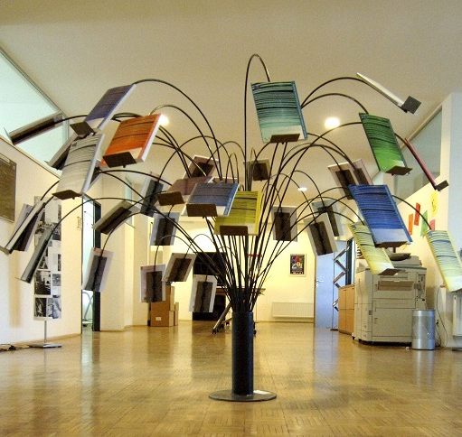
Council of Europe resources to support language learning pathways
Presentation overview
Introduction
Language teacher competences
Plurilingual education
Autonomous learning:
  Mobility
  Digital literacy
  Critical thinking skills
Whole-school/systemic approaches

Slide 2



Language teacher competences: current activities
Project: Towards a CEFR for language teachers
Project: Action research communities for language teachers
Training and Consultancy: using EPOSTL
Notes:
Why teacher competences matter:
QUESTION 6 - How would you define the teacher’s role in promoting and supporting language learning pathways?
Les réponses à cette question sont unanimes dans l’appréciation positive du rôle que l’enseignant a à jouer dans la promotion et le soutien des parcours d’apprentissage linguistique.
Les adjectifs utilisés en sont la preuve : general and central, (extremily) important, more important than ever, essentiel, crucial vital, PRIMORDIAL, positive and growth mindset, one of the most essential parts in supporting a student’s way to language acquisition …)
un modèle : The teacher is the example. Responsibility as a role model in attitudes towards plurilingualism and the value of all languages in a classroom. Teacher is a guide and role-model. As a life-long learner.
un conseiller, un guide : The teacher role would be the one of an advisor. The teacher must be supportive and guide the students.
un professionnel qui suscite la motivation : Crucial as a motivator. Teachers are essentially motivators.
un facilitateur et un accompagnateur : L'enseignant doit progressivement passer du rôle d'enseignant à celui d'accompagnateur actif des apprentissages (logique de la classe inversée). Facilitators. Natural language partners of their students.
un médiateur : an intercultural mediator (entre les cultures). The teacher is also the ambassador of the student, in the sense that the teacher prepares those people in the next stage of education to take the following steps with the student (entre les niveaux scolaires).
What initiatives are currently being taken / could be taken by other educational institutions in your society to enrich and further develop language learning pathways?
Approaches and methods
-development of a national framework for Languages and Pluriliteracies for teaching professionals which sets out expectations of all teachers in terms of their professional values and attitude and knowledge and understanding of language(s) for and in learning -
/
Need a sort of CEFR for pedagogy, not only for language - towards a CEFR project!
Towards a CEFR:
Teacher competences relating to language teaching and languages in education are crucial factors in the quality and effectiveness of education.
Several previous projects have generated frameworks and descriptions of many of these competences.
However, no overview of these frameworks and their potential uses, and no overarching framework covering all aspects of languages in teaching yet exist.
This project seeks to bridge these gaps.
Agreed outputs: analysis of existing tools with identifcation of gaps; navigation guide with examples of use; inventory of competences; consideration of need for a “CEFR” for language teachers
Have analysed:
28 frameworks and tools for language teachers from various countries
12 other frameworks for teachers of all subjects
18 other documents relevant to the topic of teacher education and teaching competences
GO TO LINK – ALSO OVERVIEW OF RESOURCES TAB.
final w/shop in October 18.
Within this, focus on supporting teachers develop plurilingual competences – new Project related to CARAP – REFDIC.
Toawards a f/w of competences for training teachers in using pluralistic approaches. Based on CARAP – f/w for learners but thinking about stage before – if a teacher is meant to develop certain knowledge, skills and attitudes in their learners, what are the knowledge, skills and attitudes that the teacher needs?
Also action research Project: helping Ts bridge research and practice - to contribute to the improvement of language education by giving teachers across Europe better access to action research and new perspectives on languages methodologies.
Agreed outputs: Guidelines for action research and for networking strategies towards quality enhancement in language teaching;
A practical guide to action research for teachers and teacher educators based on experiences from the ECML countries;
Piloted models of trialled course units: format for training units to improve classroom practice through linking quality strategies to practical action research approaches (brochure including checklist and reflection);
A set of success stories in several languages;
Online platform with a bank of resources, including key documentation, and didactic materials. (online egs of small-scale AR projects from 2016 w/shop participants)

Slide 3
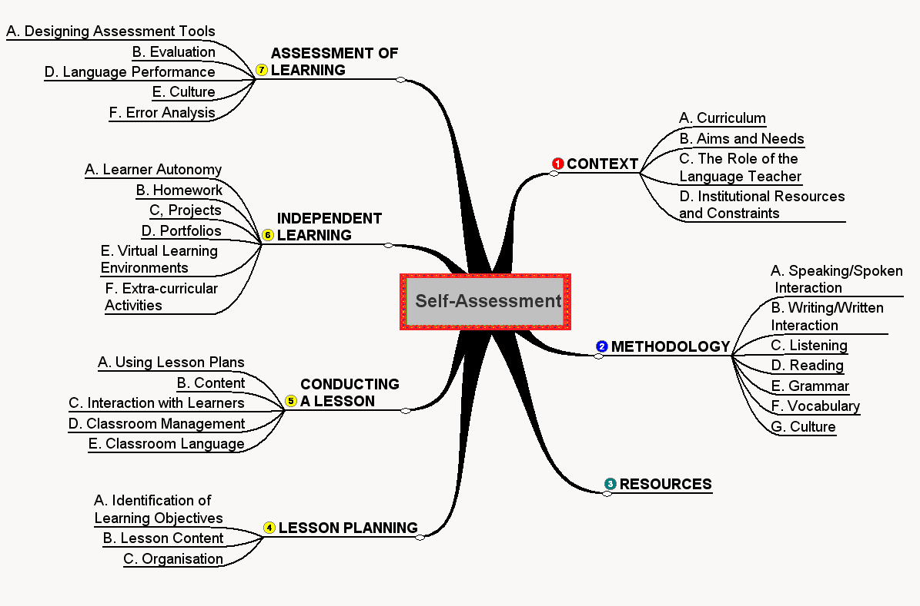

Slide 4

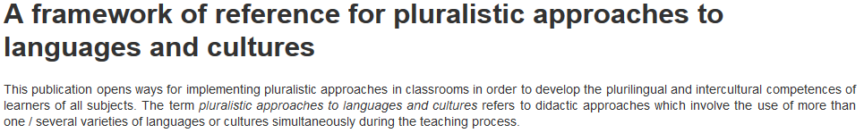
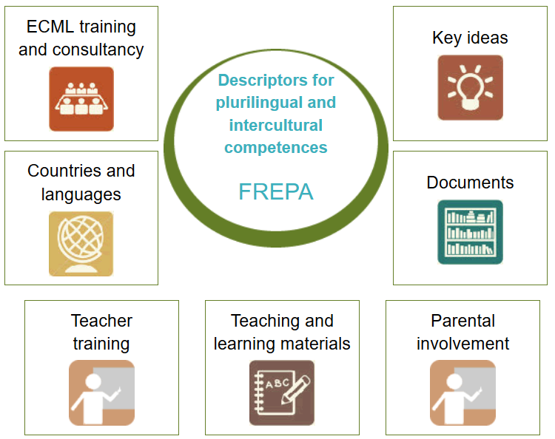
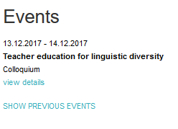

Slide 5
 | Knows that each language has its own, partly specific, way of °perceiving / organising ° reality
 | Positive acceptance °°of °linguistic / cultural° diversity / of others / of what is different°°
 | Can use knowledge and skills already mastered in one language in activities of °comprehension / production° in another language
 | Knows that one can have a °multiple / plural / composite° identity
 | Curiosity about a °multilingual / multicultural° environment
 | Can compare different cultural practices
Notes:
5

Slide 6

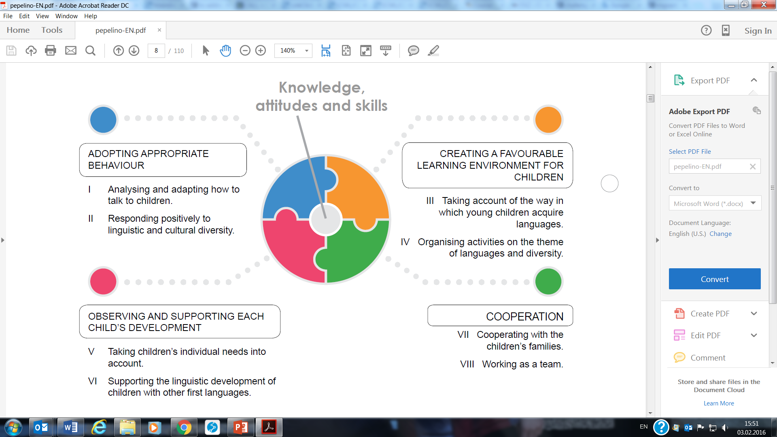
PEPELINO: European portfolio for pre-primary educators

Slide 7

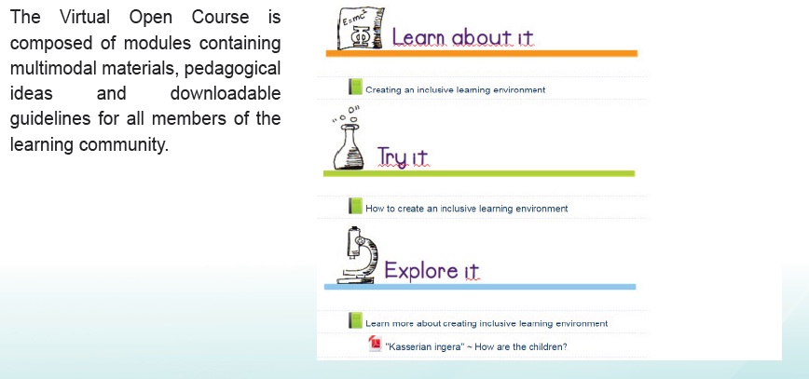
Collaborative community approach to migrant education
Creating an inclusive learning environment
Identifying issues and ways forward
Challenging our own attitudes
Opening the classroom to the community
Working together towards literacy
Making space for learners’ languages
Creating multilingual resources

Slide 8
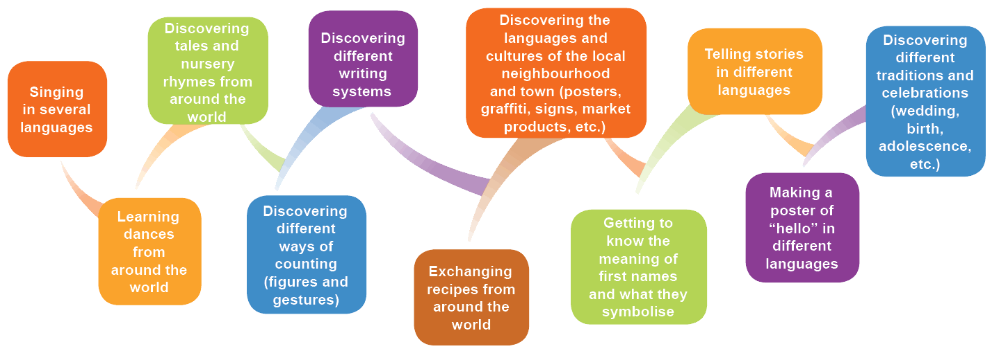
Parents and teachers: working together for
plurilingual and intercultural education
http://parents.ecml.at/

Slide 9
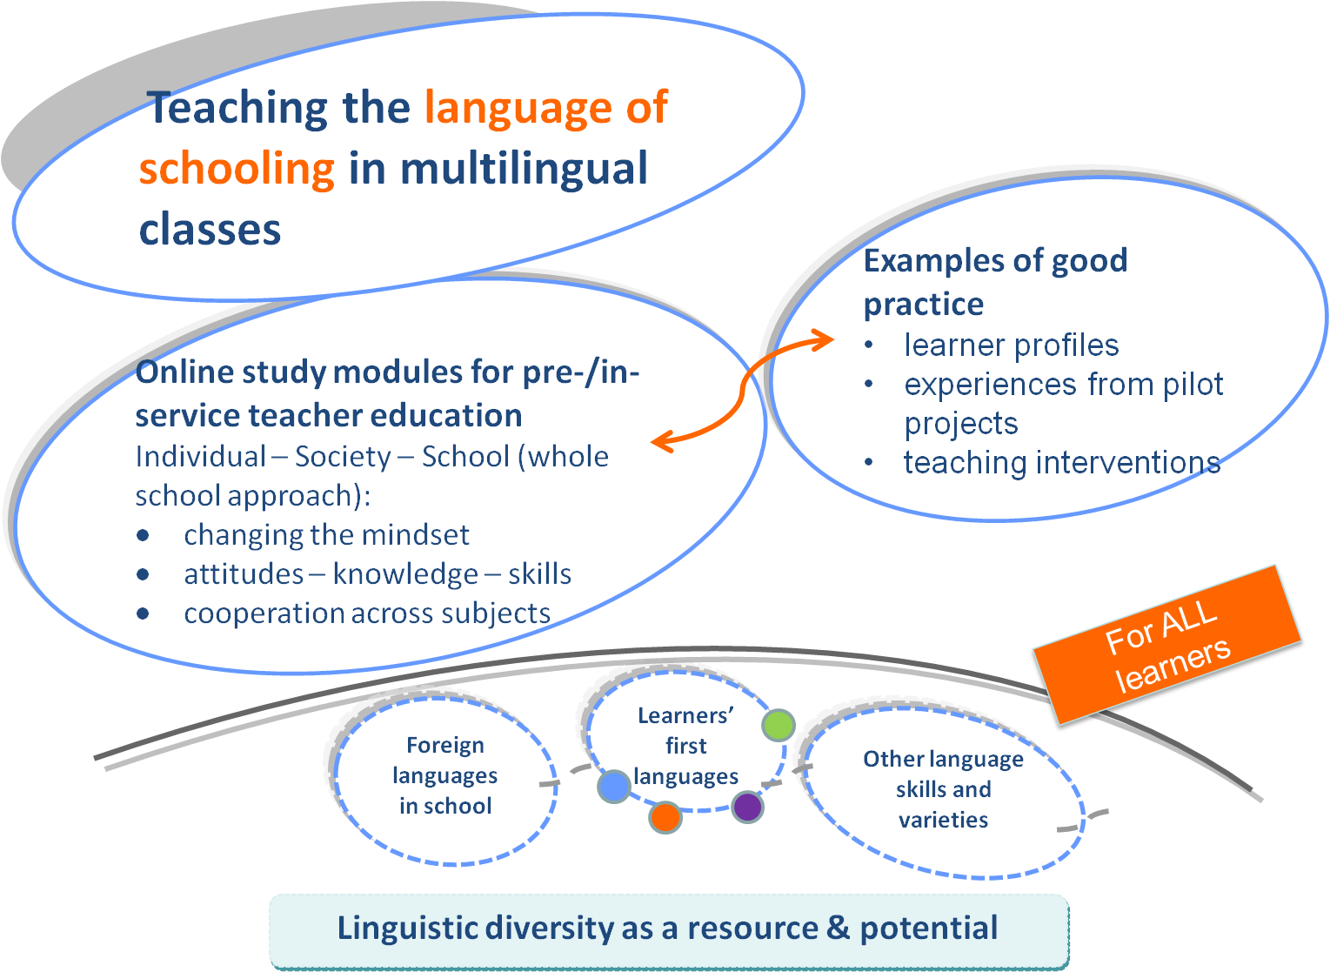

http://marille.ecml.at/Classroomvideos/tabid/2915/language/en-GB/Default.aspx

Slide 10
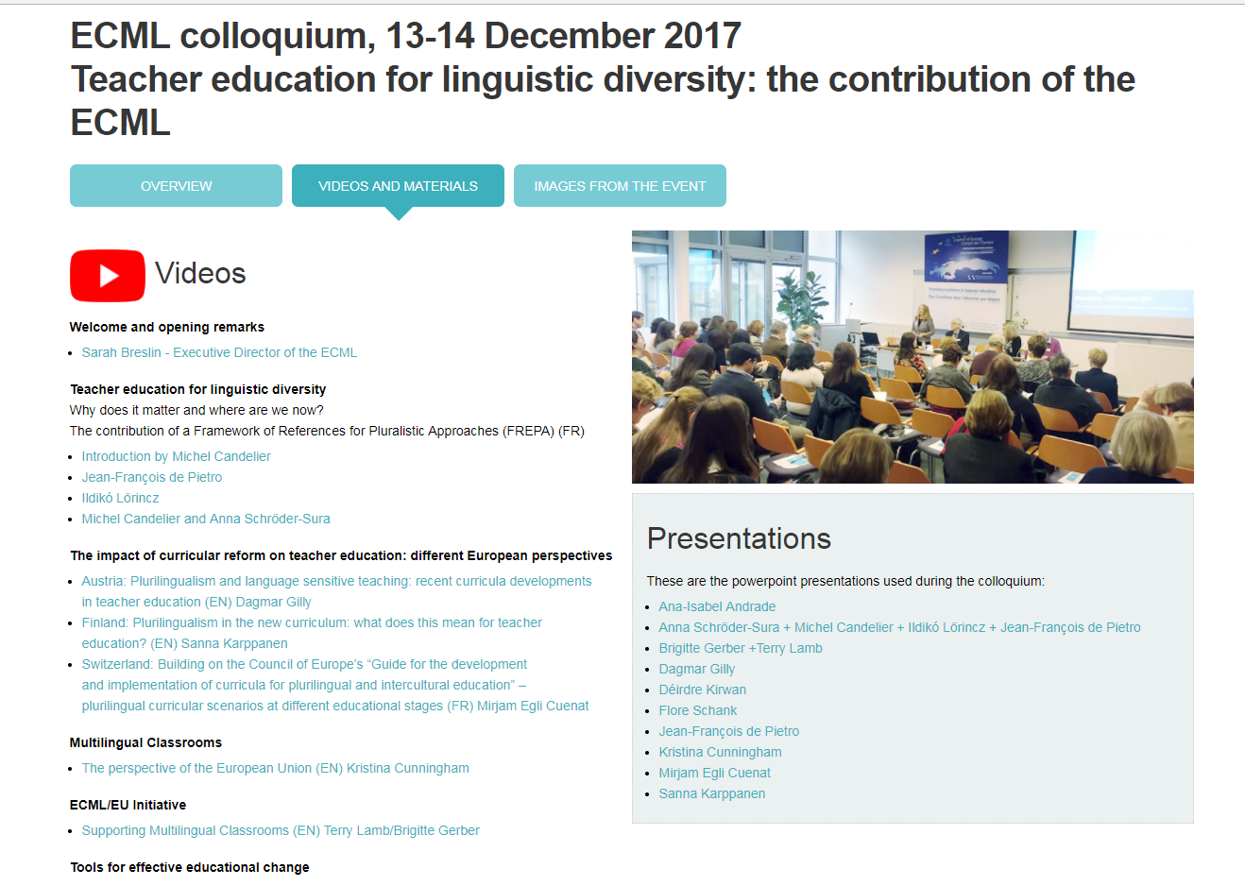

Slide 11

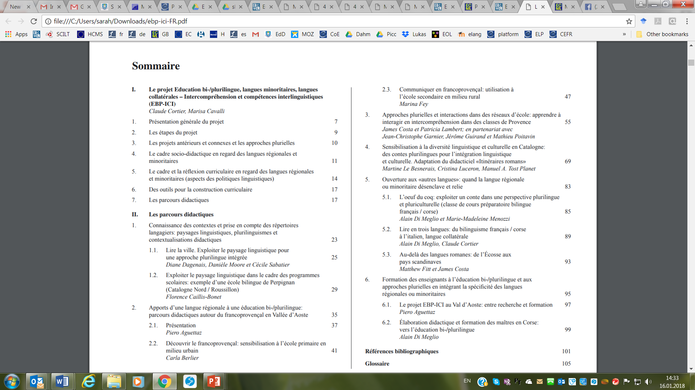
Langues régionales/minoritaires dans l'éducation bi-/plurilingue
Training and consultancy: Quality education in Romani for Europe

Slide 12


Training and Consultancy: Supporting multilingual classrooms
Flexible modules:
  Supporting all language teachers in multilingual classrooms
  Supporting all teachers with language development across the curriculum
  Developing a whole-school approach to valuing and supporting linguistic and cultural diversity
Key features:
  Starting point: the participants and their particular needs but also their expertise
  Draws on a range of ECML resources

Slide 13
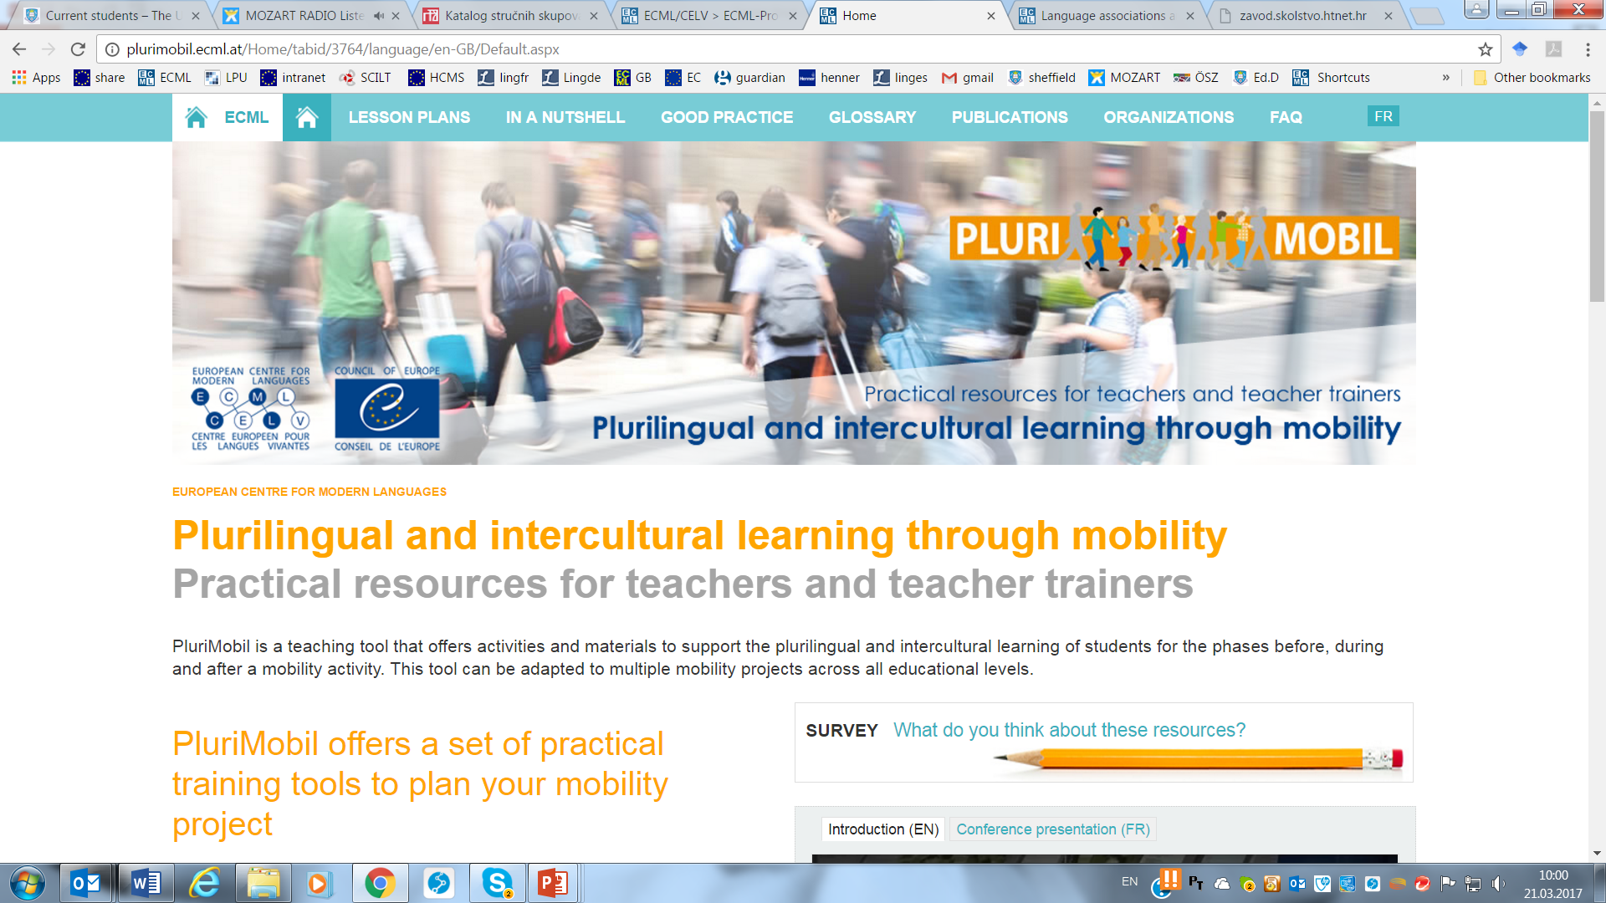
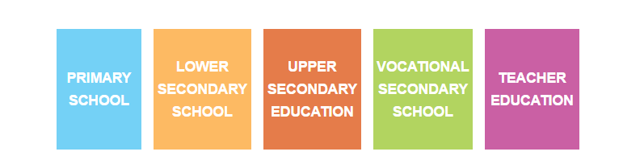

Slide 14

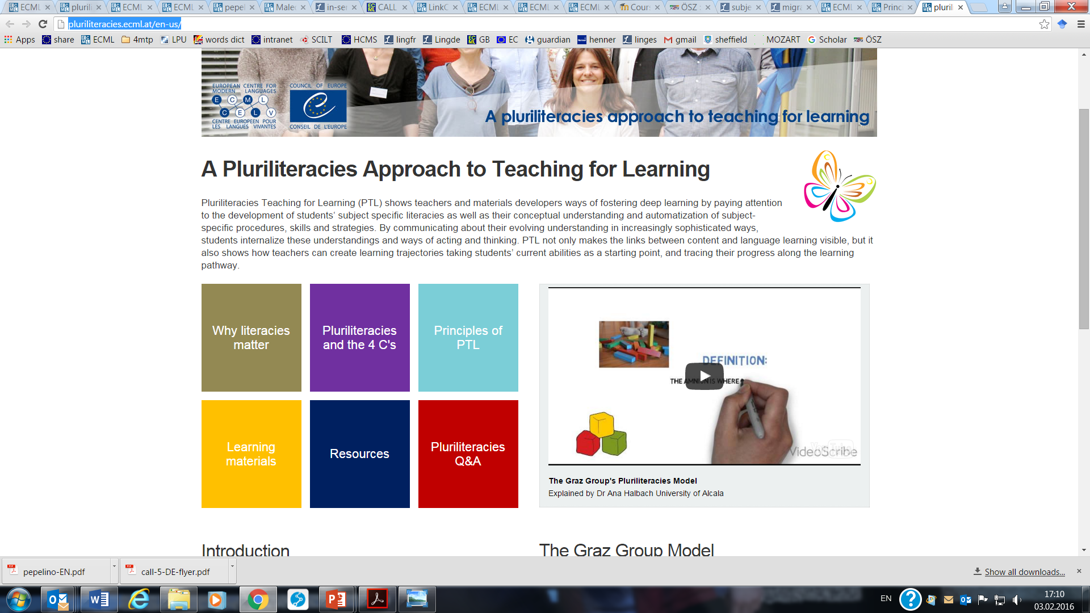
A pluriliteracies approach to teaching for learning : moving beyond traditional CLIL
“Deeper learning
is the ability
to take what was learned in one situation and apply it to another situation.
Through deeper learning
(which often involves shared learning and interactions with others in a community), our students develop expertise
in a particular subject and
they master
the unique ways
of the subject.”
(Pellegrino & Hilton 2012)

Slide 15


Digital literacy for the teaching and learning of languages
Supporting teachers develop their learners’ critical thinking skills and learner autonomy through a reflective use of online resources and technologies
Increasing learner motivation through “real-world” tasks – e.g. editing a Wikipedia website
Moodle platform with training modules; examples of promising practice using real-world tasks

Slide 16
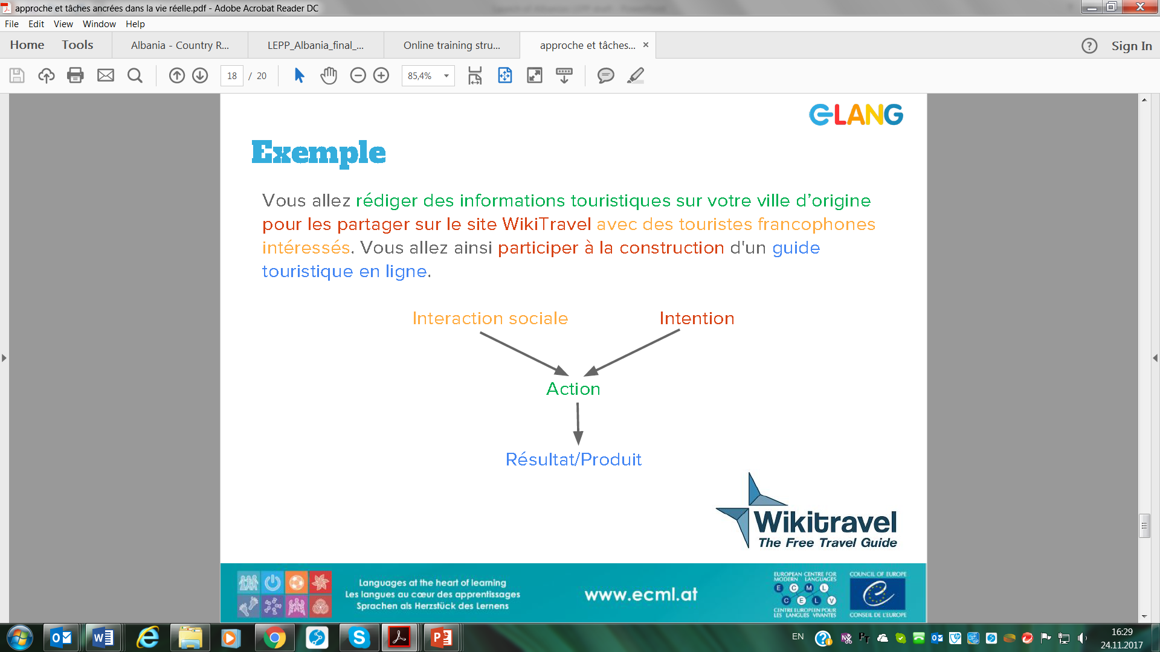

Slide 17
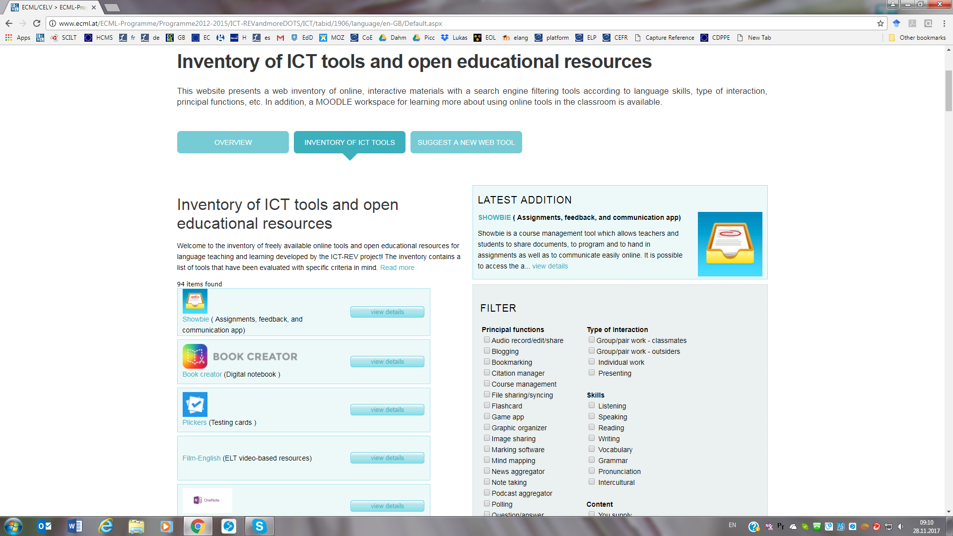
Notes:
Maybe more about independent learning whereas e-lang more about autonomous learning.
LINK; what about the CEFR? What new tools/projects/ activities do we have on offer?

Slide 18

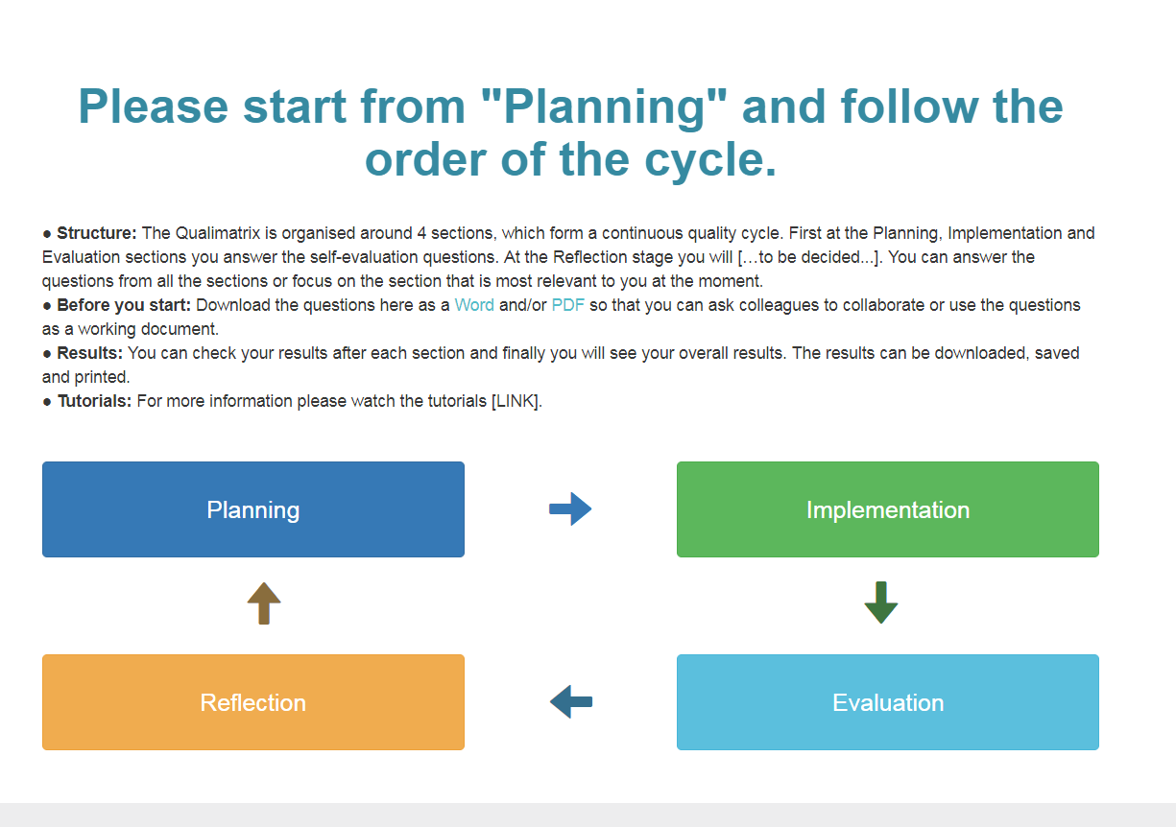
A quality assurance matrix for CEFR use

Slide 19


Current developments: Promoting excellence in sign language instruction: ProSign2
Agreed outputs:
a professionally-oriented competency framework for sign language teachers
a European language portfolio
B2 level materials and learning activities from different European sign languages

Slide 20
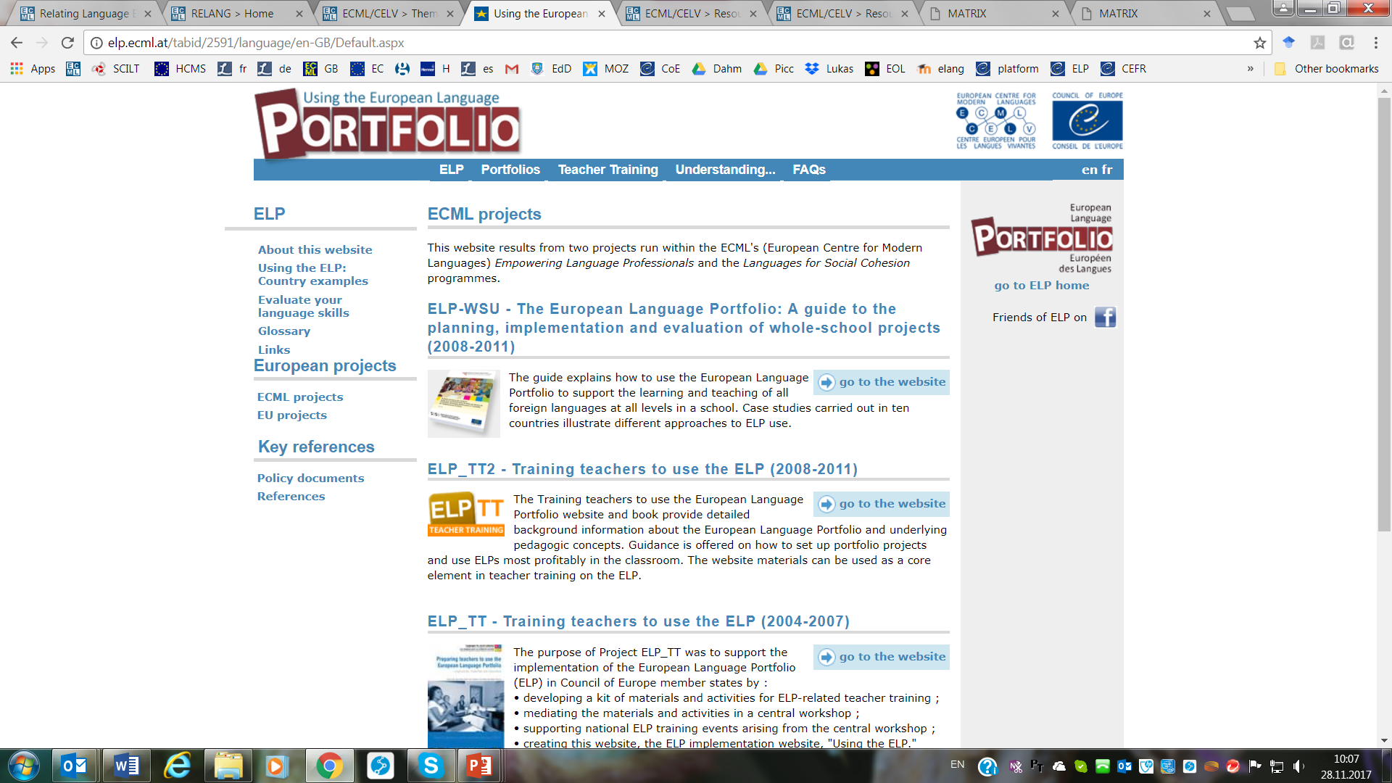

ELP implementation
Today’s
think tank!
Training and Consultancy: using the ELP
https://www.coe.int/en/web/portfolio

Slide 21



Language skills for successful subject learning:
CEFR-linked descriptors for mathematics and history
Suggestions for use:
For raising awareness of the language-related aspects and the importance of language in constructing knowledge in non-language subjects
For setting language objectives in lessons
For use as assessment criteria (formative and summative)
For gauging the language level used by teachers in subject clases and adapting it accordingly
“Whatever the subject, all knowledge building in the school context involves working with language.”(Beacco et al, 2010)
Project: Developing language awareness in subject classes

Slide 22




CEFR implementation
Assessment of young learner literacy linked to the CEFR (AYLLit)
Encouraging the culture of evaluation among professionals
CEFR – level estimation grid for teachers (CEFESTIM)
Guidelines for task-based university language testing
(GULT)
https://www.coe.int/en/web/common-european-framework-reference-languages

Slide 23
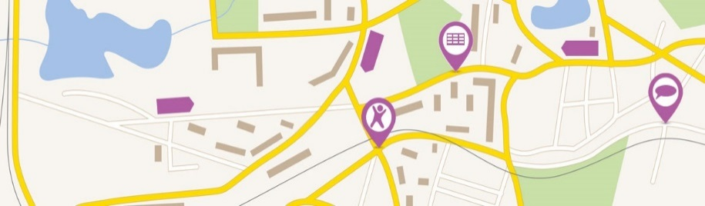

Whole-school approaches
Project: A roadmap for schools to support the language(s) of schooling
Project: Learning environments where modern languages flourish

Slide 24
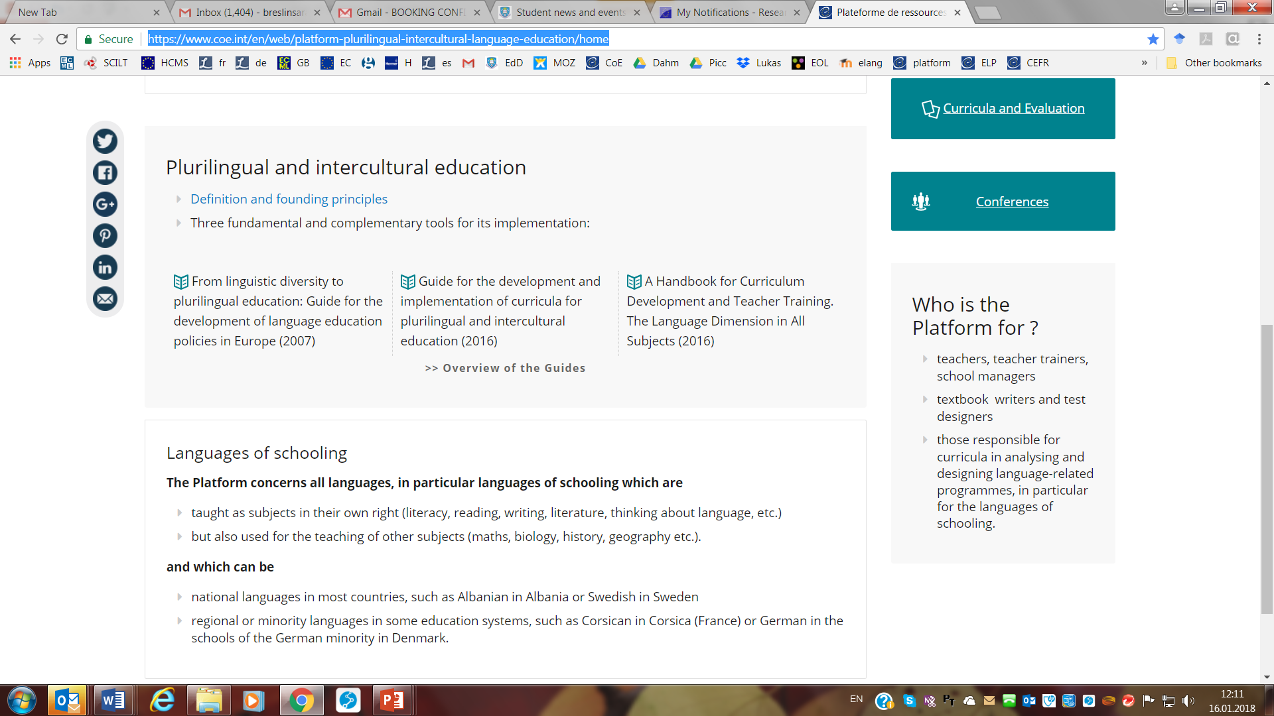
https://www.coe.int/en/web/platform-plurilingual-intercultural-language-education/home
The place of the languages of schooling in the curricula
Education, mobility, otherness: the mediation functions of schools

Slide 25

« Knowledge of languages is the doorway to wisdom » Roger Bacon

